Slide 1
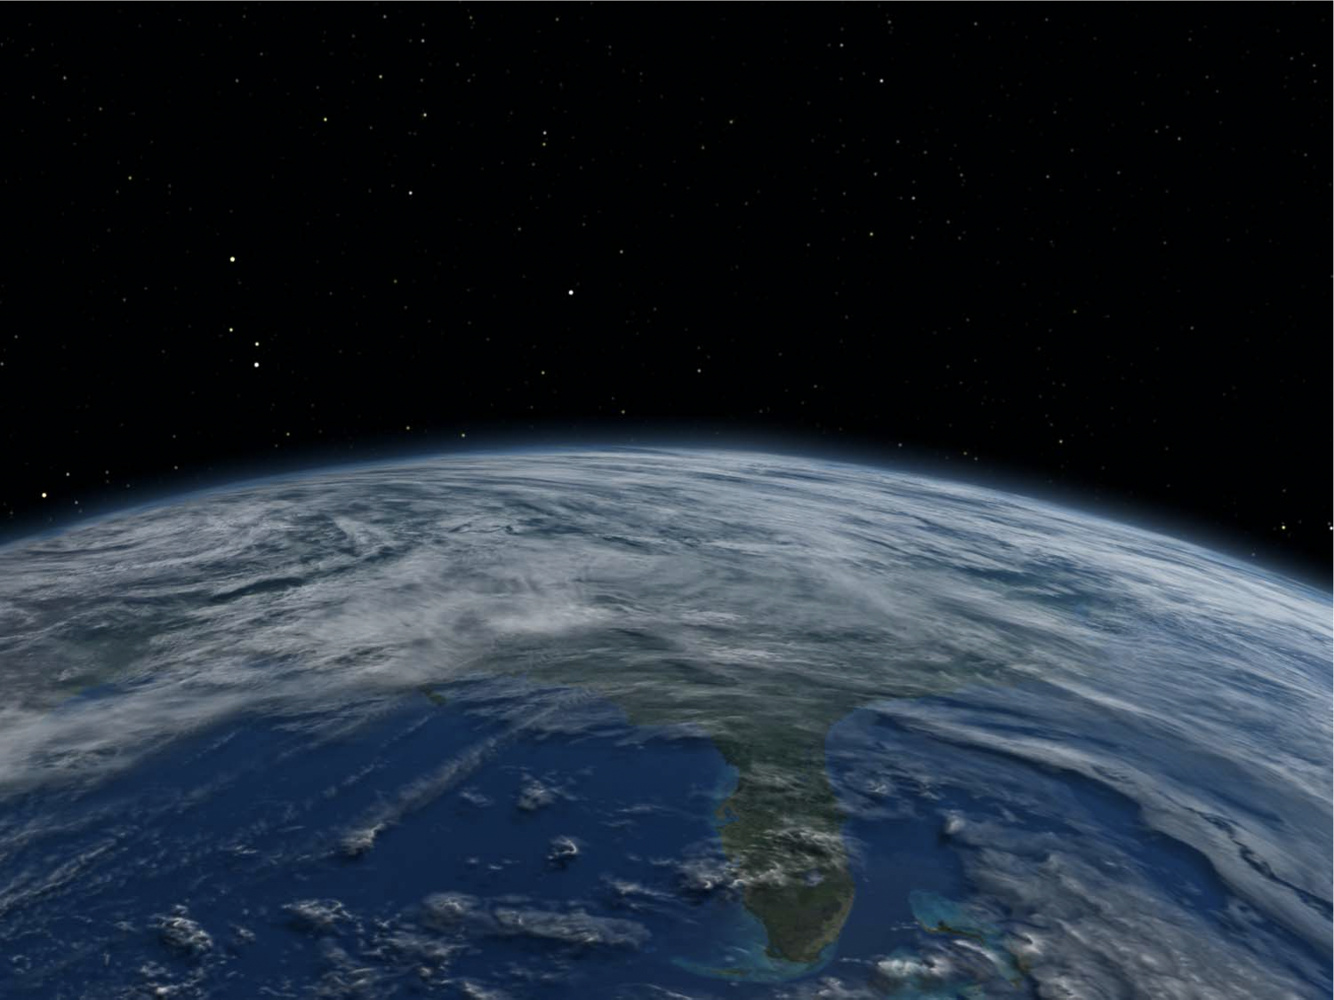


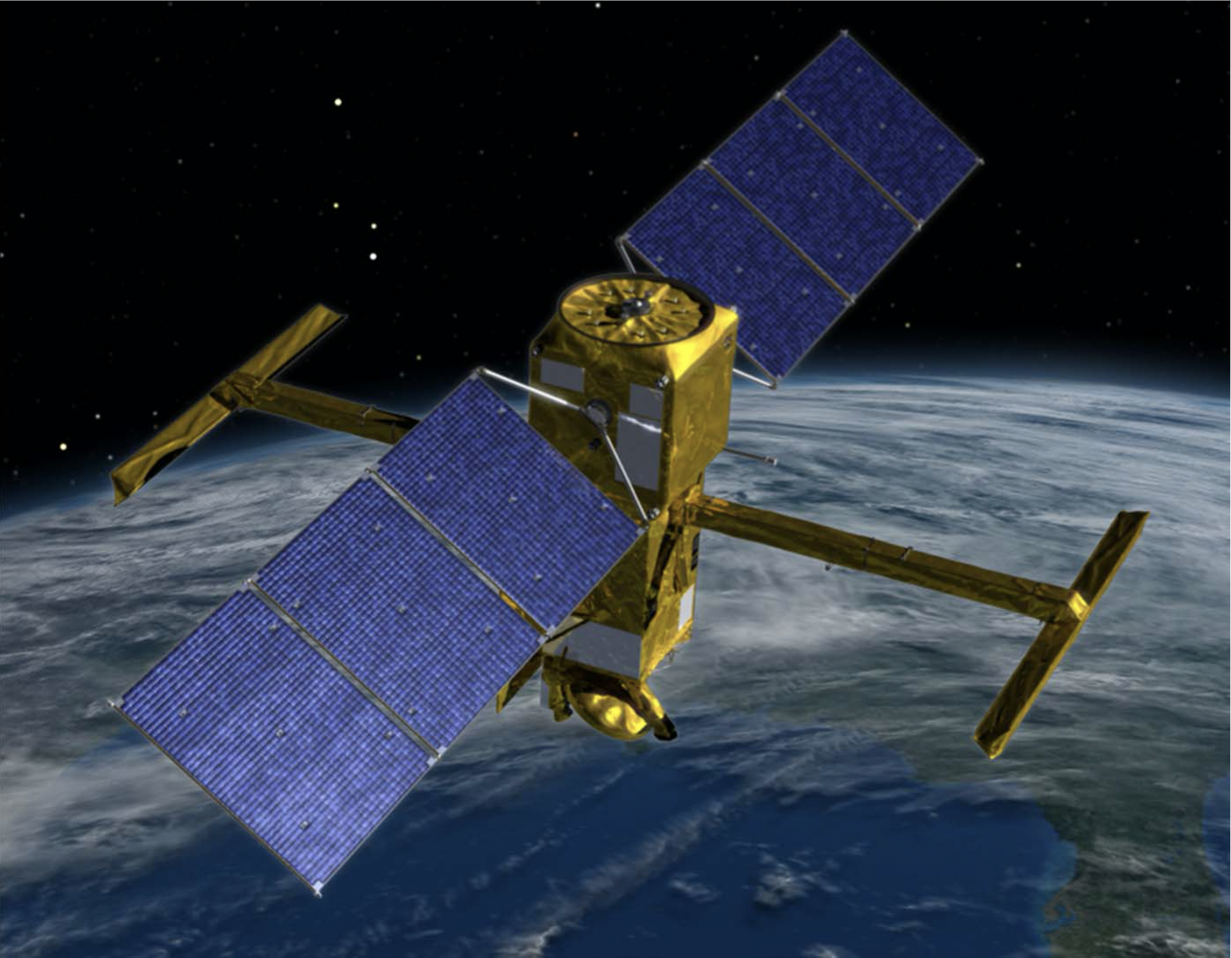


SWOT Hydrology Data Products:
An Introduction
Tamlin M. Pavelsky
Professor, University of North Carolina
&
Hydrology Science Lead, SWOT
Contact: pavelsky@unc.edu

Slide 2
SWOT (Surface Water and Ocean
Topography mission)
Slide Source: Tamlin M. Pavelsky
Professor, University of North Carolina

Slide 3
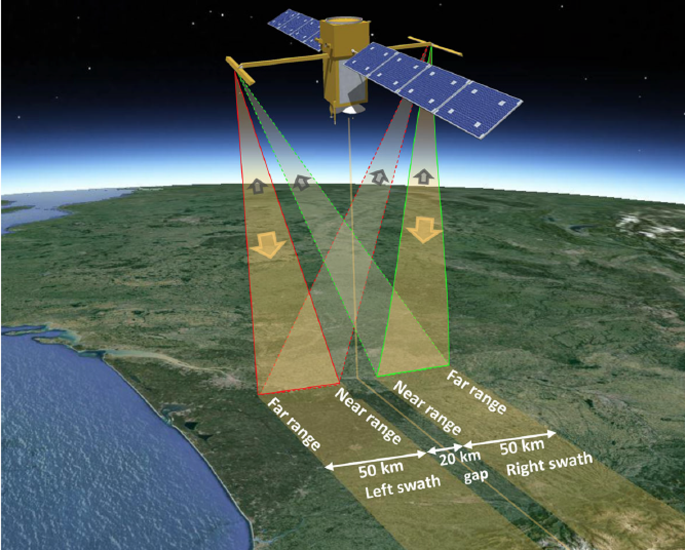
The Surface Water and Ocean Topography Mission
SWOT is a Ka-band Radar Interferometer that is designed to measure the variations in the world’s rivers, lakes, and oceans
21-day repeat orbit at 890 km.
Scheduled for launch in late 2022
3.5 year nominal mission lifetime.
Designed to measure rivers as narrow as 50-100 m
Capable of measuring lakes as small as ~250 m x 250 m.
Simultaneously measures inundation extent and water surface elevation
Total budget: ~$1.1B
Biancamaria, Lettenmaier, and Pavelsky, SoG, 2016

Slide 4
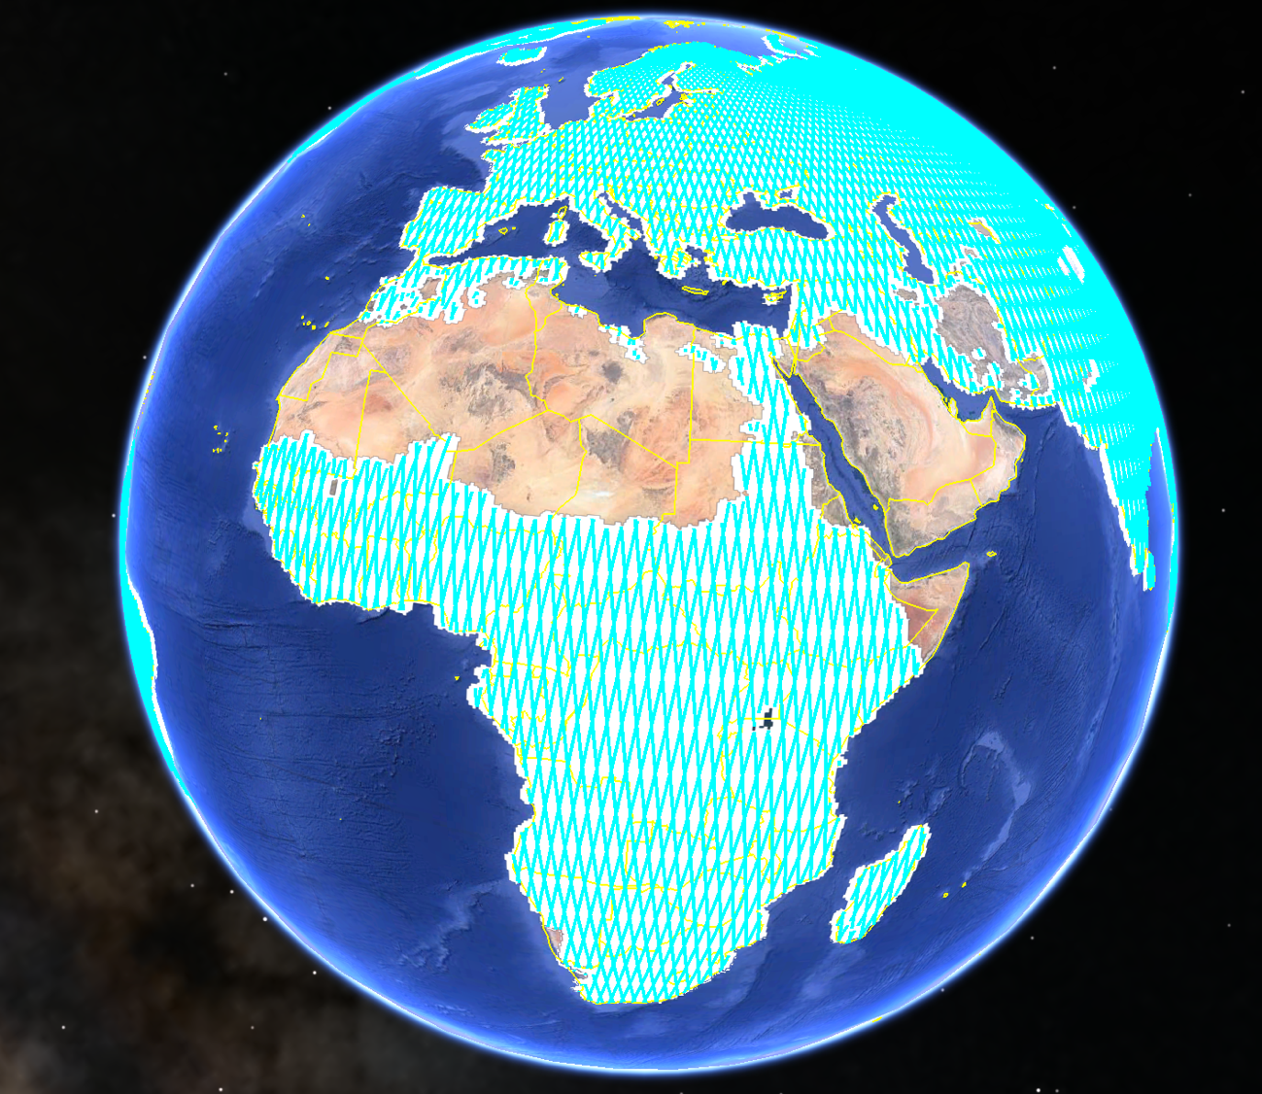
SWOT High-rate data, optimal for hydrology, will be downloaded over only a portion of the Earth’s
surface.
This is due to
limitations in
satellite downlink
capacity.
High Rate (HR)
Low Rate (LR)

Slide 5
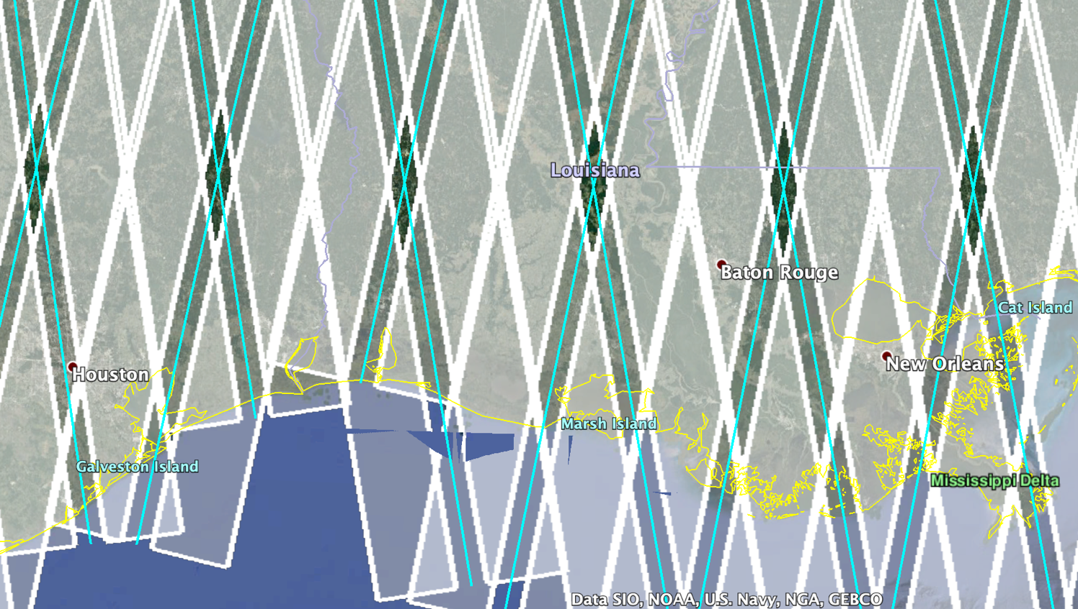
SWOT HR Data Coverage
SWOT HR data will cover most non-desert land surface areas at least once per 21 days, but there are some small areas (see diamonds above) that are never covered. Most areas will be covered at least twice.

Slide 6
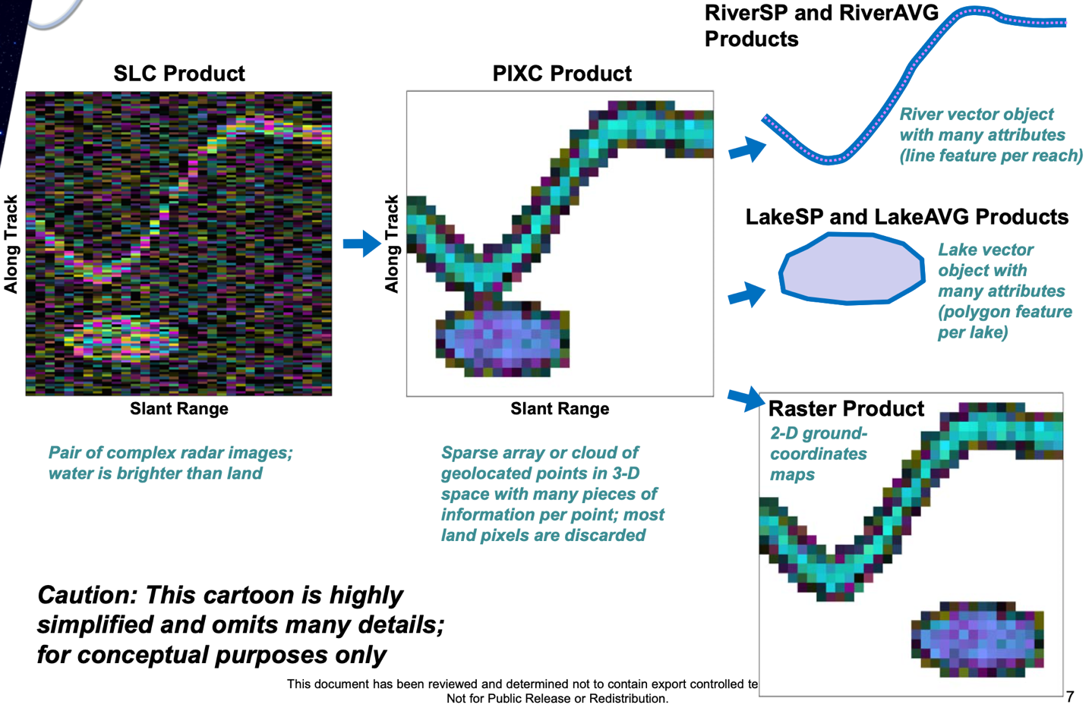
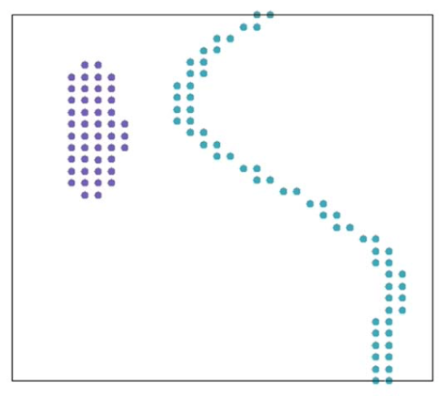
Conceptual Diagram of SWOT Data Products
Level 2 (L2)
Geolocated
Level 1 (L1)
Courtesy Curtis Chen, JPL

Slide 7
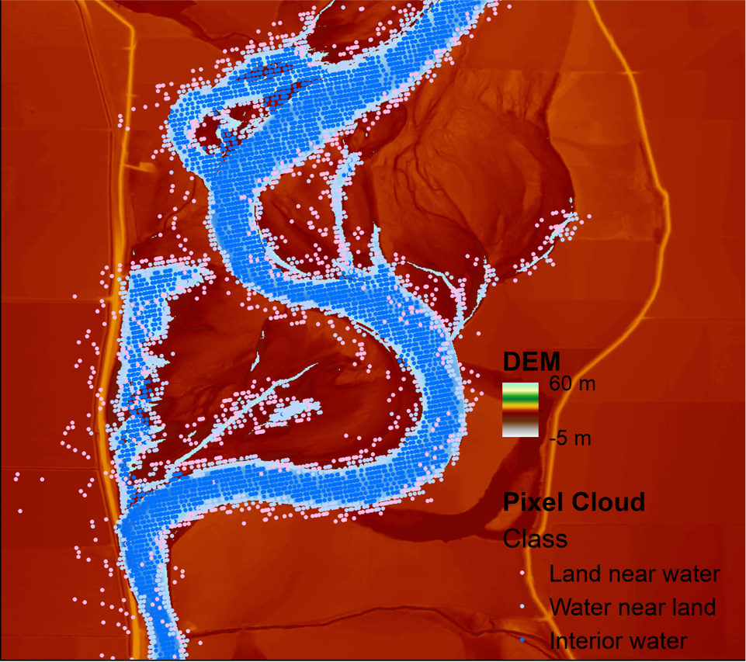
The SWOT Pixel Cloud Product
Each pixel in the pixel cloud product will have attributes including:
Water Surface Elevation
WSE Error
Inundation Extent
Inundation Error
Lat/Lon Location
Cross-track distance
Quality Flags
Radar Brightness
Radar Coordinates
The Pixel Cloud is the ”rawest” product that we recommend hydrologists use.
It will be distributed in NetCDF Format.
Figure Courtesy Rui Wei, Ohio State
Name: HR_L2_PIXC

Slide 8
SWOT River Data Products
~10 km reach
Pixel Cloud Locations
SWOT ground track
Node Locations
GRWL Centerline
Names: HR_L2_RiverSP
HR_L2_RiverAvg
Courtesy Joe Turk, JPL

Slide 9
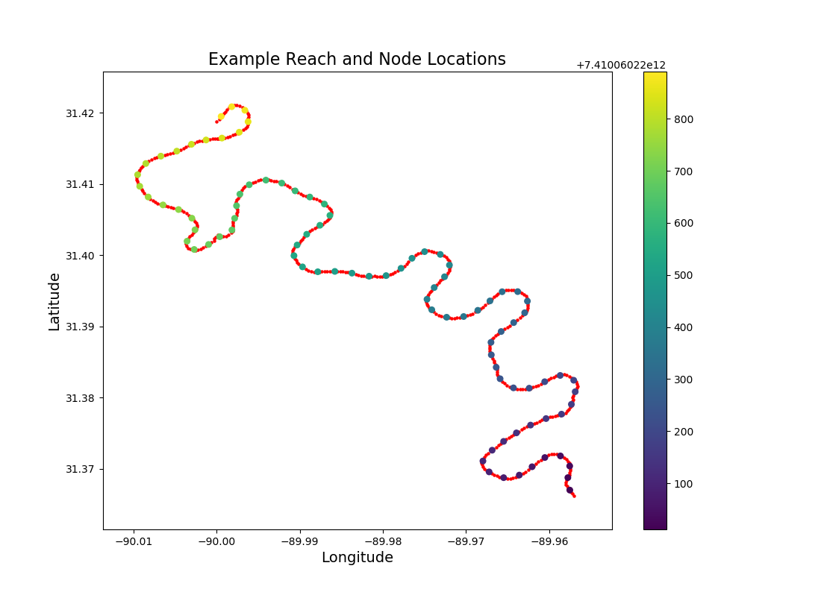
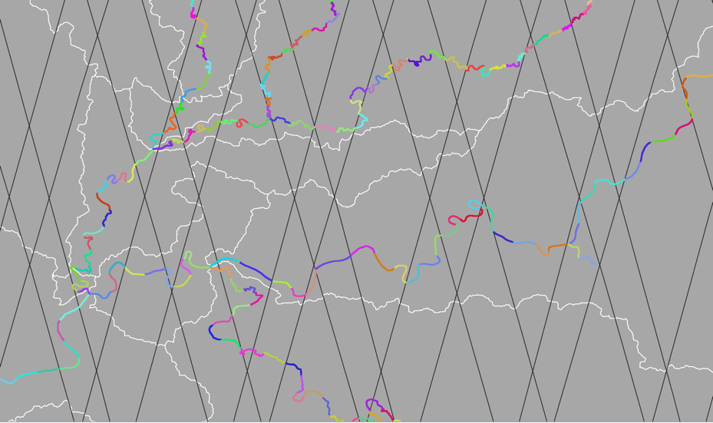
SWOT River Data Products
Node Products (~200 m spacing)
Water Surface Elevation
Inundation Extent
Width
Uncertainties
Data Quality Flags
Reach Products (~10 km long)
Water Surface Elevation
River Slope
Inundation Extent
Width
Uncertainties
Data Quality Flags
SWOT Boundaries
Basin Boundaries

Slide 10
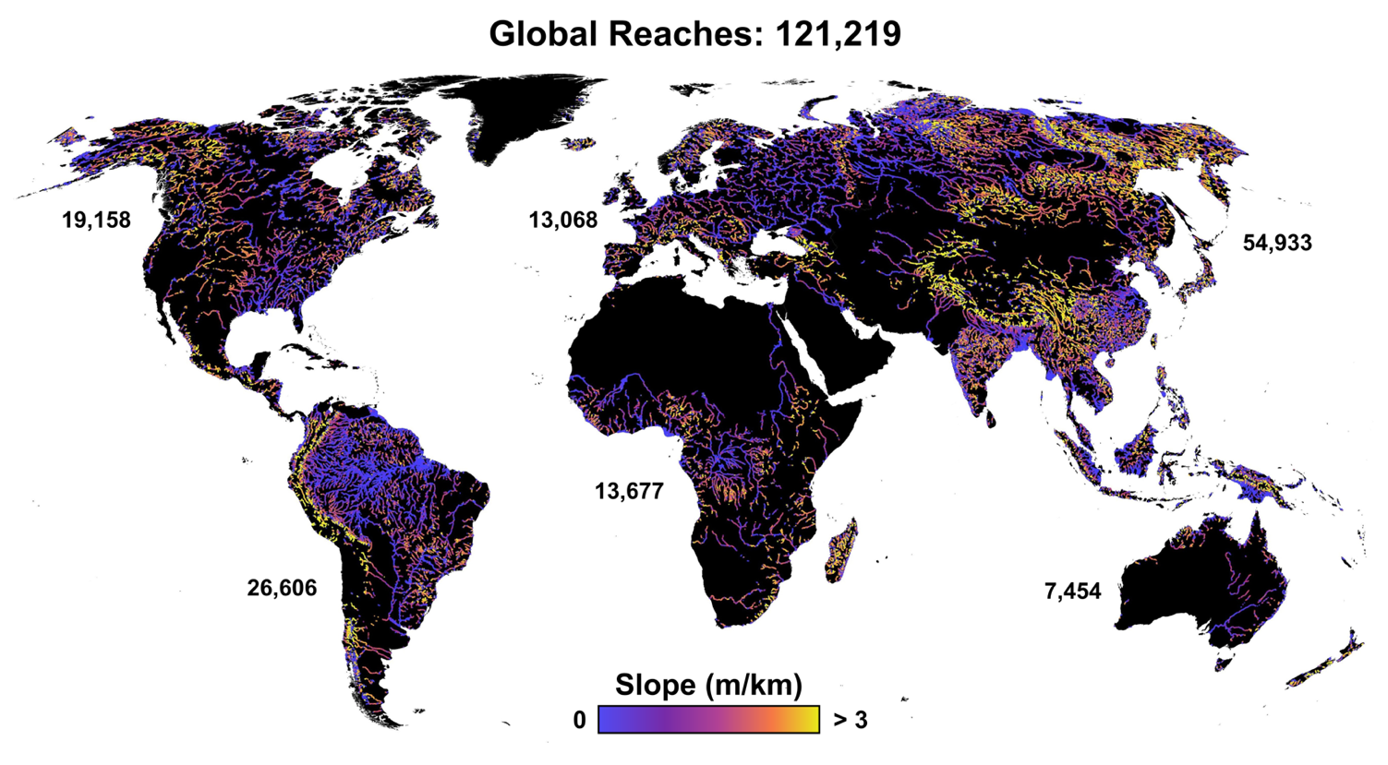
SWOT Spatial Coverage
By combining GRWL with other datasets, we have developed an a priori set of SWOT reaches and nodes that will be the framework for SWOT river studies.
Slide Courtesy E. Altenau, UNC

Slide 11
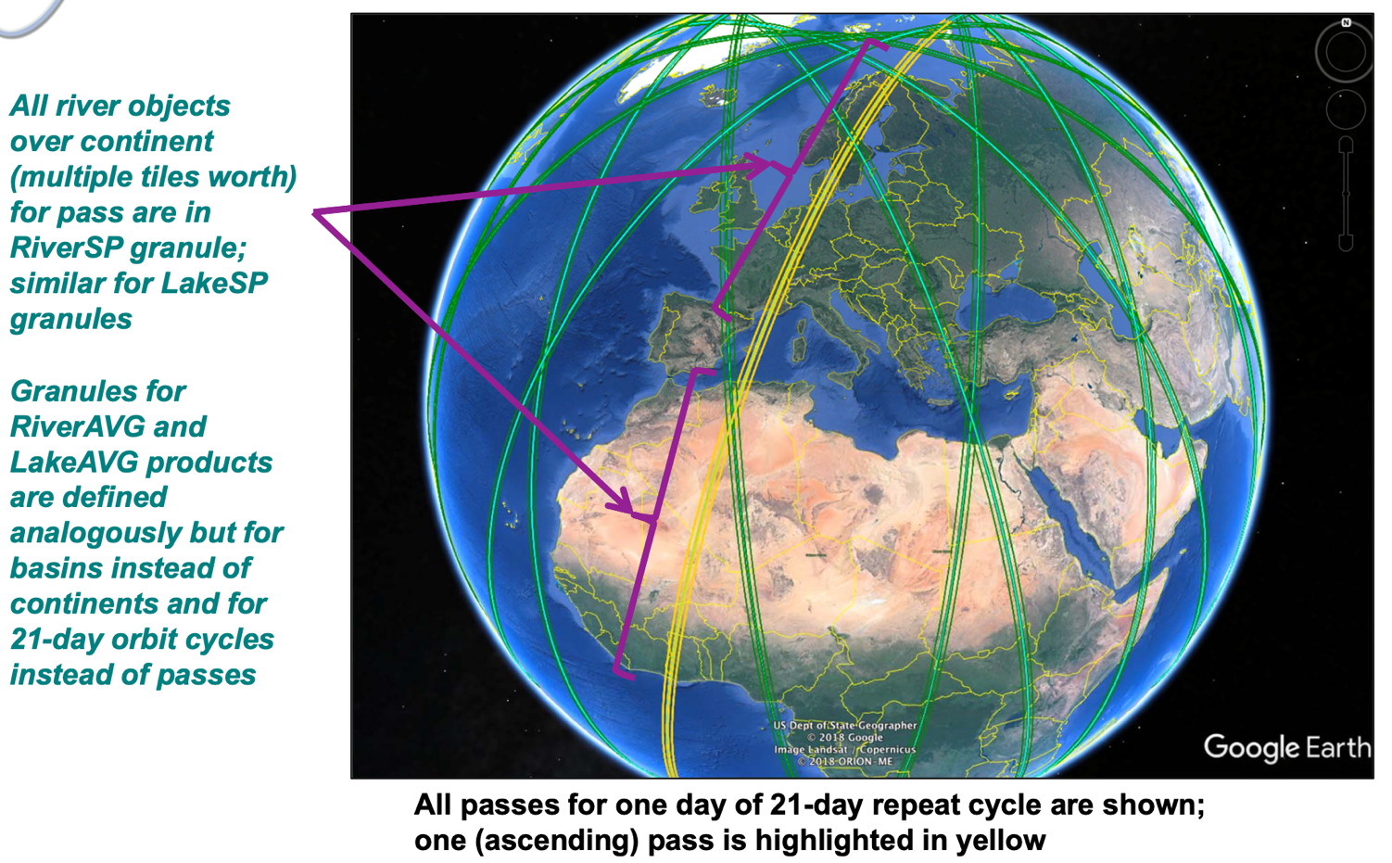
SWOT River Data Granules

Slide 12
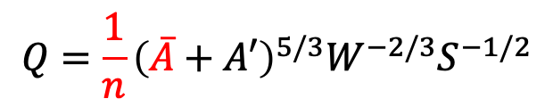
SWOT Discharge Algorithms
Because SWOT can measure river width, slope, and water surface elevation, it can be used to estimate discharge using a simple flow equation like Manning’s Equation:
$$Q=\frac{1}{n}{\left(\overline{A}+A′\right)}^{5/3}W^{−2/3}S^{−1/2}$$
Simulation results suggest that we can expect discharge RMSEs of about 50%, but RMSEs for variations in discharge of about 10-15%.
Estimates of discharge on the Seine River from three SWOT discharge algorithms.
Implication: we will be able to measure the dynamics of discharge very accurately with SWOT.
Figure Courtesy M. Durand, Ohio State

Slide 13
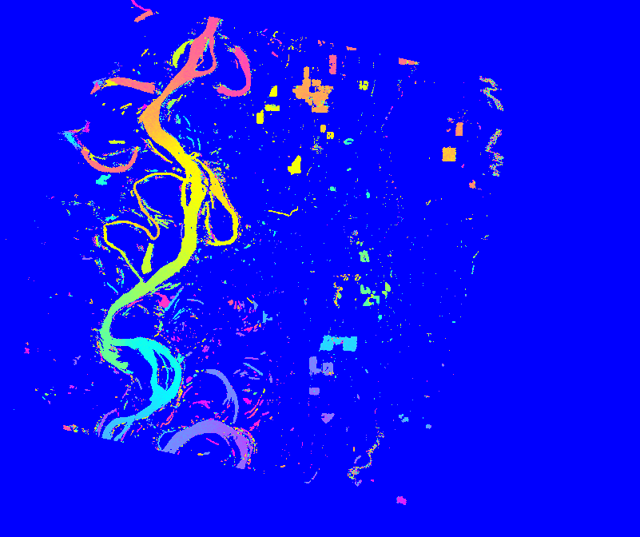
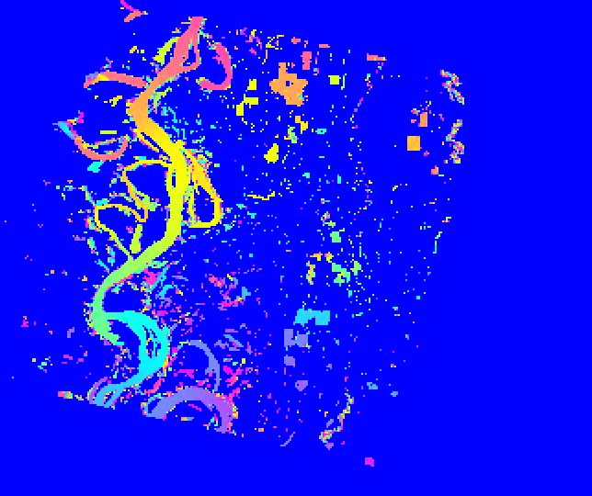
Raster Standard Data Product (SDP)
100m Raster – 2367/497L – 10m height wrap
Coordinate System: UTM
Resolution: 100m and 250m
Grid: Geographically fixed grid.
Grid will be aligned with center of the UTM zone corresponding to the middle of the granule.
(500km easting, 0km northing in the northern hemisphere and 10,000km northing in the southern hemisphere)
Granules: 128km x 128km non-overlapping scene granules (2 x 2 set of Pixel Cloud tiles)
Coverage: Based on KaRIn HR mask
File Format: NetCDF with all rasterized layers
250m Raster – 2367/497L – 10m height wrap
Name: HR_L2_Raster

